Slide 1
Final Presentation
Deep Learning-based Biometric
Authentication
Guides: Dr. Nadera Beevi S, Rahila Firoz
Members: Abhishek SR, Anand Prakash, Amal Ashok

Slide 2
Introduction
Redefining iris authentication by integrating advanced Deep Learning techniques.
Moving beyond traditional, rule-based methods like Hough Transform, thresholding, and edge detection.
Leveraging deep learning to make iris authentication intelligent, adaptive, and future-ready.

Slide 3
Related Works
Hafeez, H., Zafar, M. N., Abbas, C. A., Elahi, H., & Ali, M. O. (2022). Real-Time Human Authentication System Based on Iris Recognition. Eng, 3(4), 693–708
Bhawna, Chouhan & Shukla, Shailja. (2021). Iris Recognition System using canny edge detection for Biometric Identification. International Journal of Engineering Science and Technology. 3.

Slide 4
Gap Identification
Existing System | Proposed System
Used Canny Edge detection / Hough Circle Transform for segmentation of iris The Hough Circle Transform detects the iris as a circle, which can include parts outside the iris Canny Edge Detection can result in the inclusion of eyelashes and eyelids To remove these unwanted parts, we need to use other preprocessing techniques Used Local Binary Patterns / Gabor Filter for Feature Extraction | Using Deep Learning Models for Iris Segmentation Deep learning models like CNNs can achieve precise iris segmentation by learning complex features to separate the iris from areas such as eyelids and eyelashes Architectures like U-Net can be adapted for accurate segmentation and exclusion of unwanted parts Using Deep Learning Model for Feature Extraction

Slide 5
Problem Statement
Accurate iris segmentation is crucial for homomorphic key generation, but traditional methods often include unwanted regions like eyelids and eyelashes.
This work aims to develop an improved segmentation approach using deep learning and preprocessing techniques to enhance accuracy and ensure secure feature extraction for homomorphic key generation.

Slide 6
Objective
Selected UBIRIS Dataset:
Chose the UBIRIS dataset for its comprehensive set of eye images, suitable for iris segmentation and key generation tasks.
Dataset Creation:
Used Label Studio for annotating and segmenting the iris regions within the UBIRIS images, generating corresponding masks for each segmented iris to create a labeled dataset for training.

Slide 7
Objective
Model Selection:
Chose deep learning models such as U-Net, TransUNet, Attention U-Net, V-Net, and Inception V3 for training, each known for its strengths in image segmentation tasks.
Model Training and Evaluation:
Trained the selected models on the segmented UBIRIS dataset, using validation data to evaluate their performance based on metrics like IoU (Intersection over Union), Dice Score, and overall accuracy.

Slide 8
Objective
Model Selection:
Compared the results from all trained models and finalized the model that provided the highest IoU, Dice Score, and accuracy, indicating superior segmentation performance.
Image Preprocessing and Enhancement:
Preprocessed the segmented images to enhance their quality, applying techniques to improve contrast and detail, making them more suitable for feature extraction in subsequent stages.

Slide 9
Methodology
Model Summary
1. U-Net
Unet features a symmetrical U-shaped structure comprising an encoder and decoder path, allowing for precise localization of features in images.Encoder-Decoder Structure: The network consists of a contracting path (encoder) for capturing context and a symmetric expanding path (decoder) for precise localization.
Skip Connections: U-Net uses skip connections between corresponding encoder and decoder layers to retain spatial information lost during downsampling, improving segmentation accuracy.
Bottleneck Layer: A central bottleneck layer enhances feature extraction capabilities, allowing the network to learn more complex representations.
Input Size: we used with images of size (128, 128, 3), But U-Net can be adapted to different input dimensions.

Slide 10
Methodology
Model Summary
2. Attention U-net
Attention U-Net is an extension of the traditional U-Net architecture that incorporates attention mechanisms to enhance feature selection during the segmentation process.
Attention Mechanism: Integrates attention gates that help the model weigh the importance of different features, allowing it to focus on relevant spatial regions while ignoring background noise.
Encoder-Decoder Structure: Retains the U-Net's classic encoder-decoder layout, enabling both context capture and precise localization.
Skip Connections: Utilizes skip connections between encoder and decoder paths to preserve spatial information and enhance feature propagation

Slide 11
Methodology
Model Summary
3. V-Net
V-Net is a volumetric neural network designed for 3D image segmentation. It employs a similar architecture to U-Net but is specifically optimized for processing three-dimensional data.
3D Convolutions: Utilizes 3D convolutional layers to capture volumetric information, enabling the model to understand spatial relationships in three dimensions.
Fully Convolutional Network: Operates as a fully convolutional network, allowing for variable input sizes and producing segmentation maps directly from input volumes.
Skip Connections: Implements skip connections between the encoder and decoder paths to preserve spatial features and enhance detail in the segmentation output.
Hierarchical Feature Learning: Employs a hierarchical approach to feature extraction, facilitating the learning of complex patterns at multiple scales.

Slide 12
Methodology
Model Summary
4. Inception V3
Inception V3 is a convolutional neural network architecture that enhances the capabilities of deep learning models for image classification and recognition tasks. It builds upon the Inception family of networks, introducing several optimizations such as factorized convolutions and label smoothing, which improve computational efficiency and model performance.
Inception Modules: Utilizes multiple convolutional filter sizes in parallel to capture features at different scales within the same layer, allowing for a richer representation.
Factorized Convolutions: Breaks down larger convolutions into smaller ones (e.g., 5x5 into two 3x3), reducing computational complexity while maintaining performance.
Asymmetric Convolutions: Employs 1x3 and 3x1 convolutions to efficiently capture spatial features with fewer parameters.
Global Average Pooling: Replaces fully connected layers with global average pooling, reducing the number of parameters and mitigating overfitting.

Slide 13
Methodology
Model Summary
5. Trans U-net
TransUNet is a hybrid deep learning model that combines the strengths of convolutional neural networks (CNNs) and transformers for efficient medical image segmentation.
It leverages the U-Net architecture for localized feature extraction while incorporating transformer blocks to capture long-range dependencies, enhancing the model's ability to understand complex patterns within the data.
Hybrid Architecture: Integrates U-Net with transformer modules to leverage both local and global context for improved segmentation performance.
Attention Mechanisms: Utilizes self-attention to enhance feature representation, allowing the model to focus on relevant areas in the input image.

Slide 14
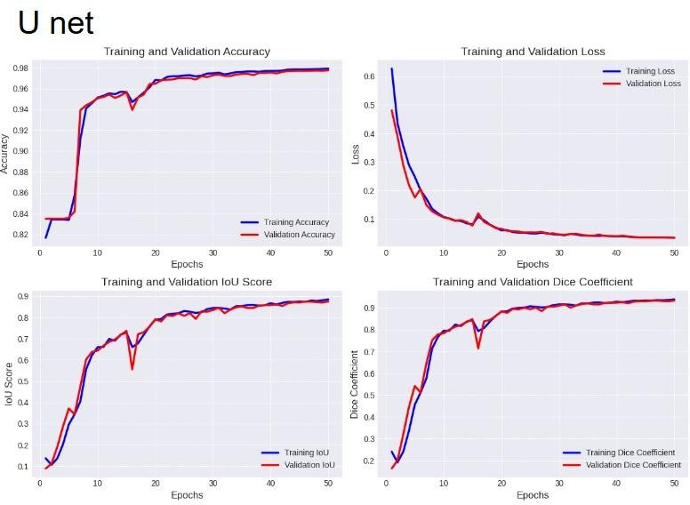
Results
U Net
Testing Accuracy:
0.9754
Testing Loss:
0.0483
Testing IoU Score:
0.8725
Testing Dice Score:
0.9381

Slide 15
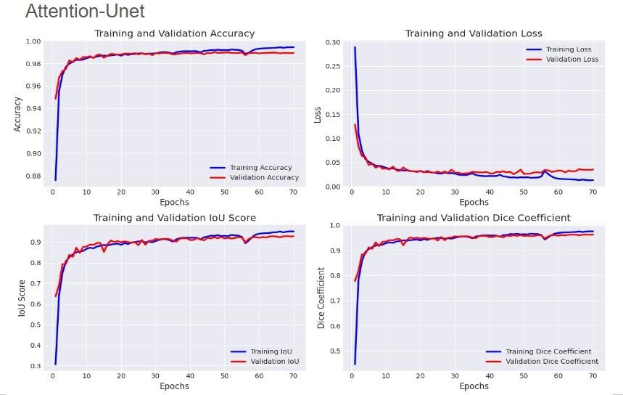
Results
Attention Unet
Testing Accuracy:
0.9886
Testing Loss:
0.0356
Testing IoU Score:
0.9162
Testing Dice Score:
0.9561

Slide 16
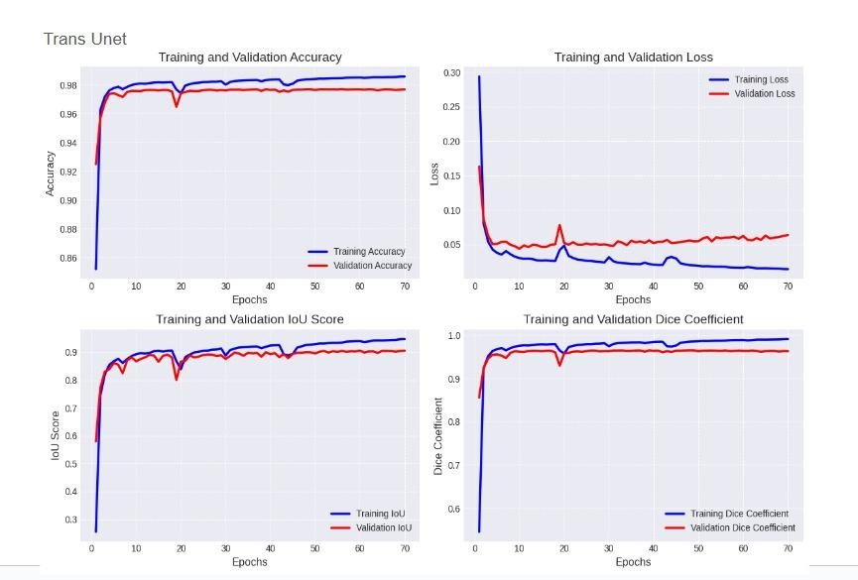
Results
Trans Unet
Testing Accuracy:
0.9761
Testing Loss:
0.0437
Testing IoU Score:
0.9161
Testing Dice Score:
0.9376

Slide 17
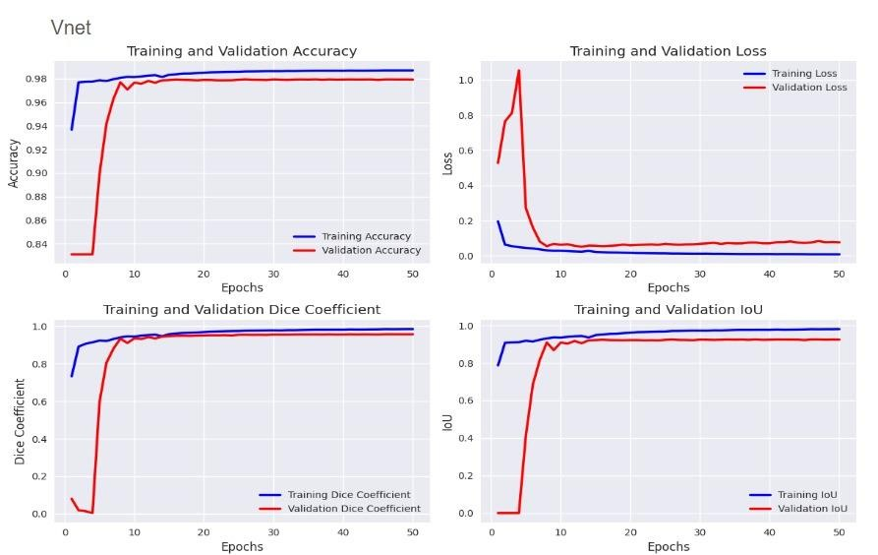
Results
V Net
Testing Accuracy:
0.9771
Testing Loss:
0.0748
Testing IoU Score:
0.9081
Testing Dice Score:
0.9475

Slide 18
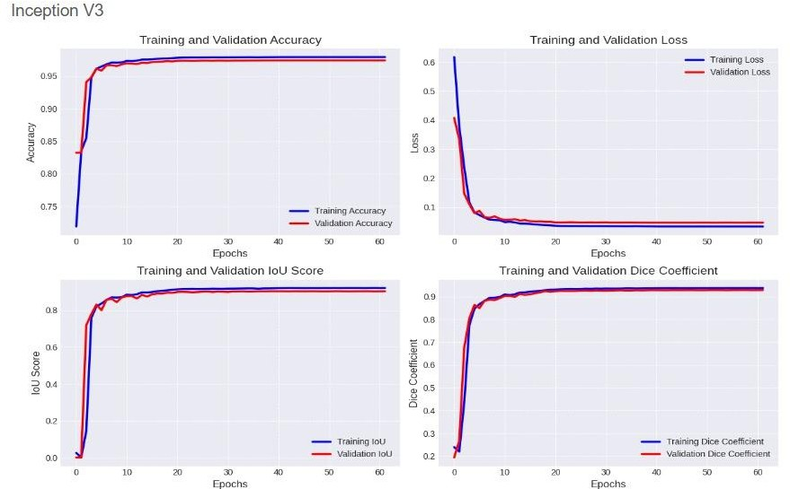
Results
Inception V3
Testing Accuracy:
0.9740
Testing Loss:
0.0471
Testing IoU Score:
0.9020
Testing Dice Score:
0.9280

Slide 19
Future Enhancement
Advanced Feature Extraction: Implement deep learning based feature extraction techniques to uniquely identify iris patterns and enhance differentiation among individuals.
Homomorphic Encryption: Utilize homomorphic methods for secure authentication, allowing computations on encrypted data without needing to decrypt it.

